Slide 1
CSE 574 Lecture 14: Reinforcement Learning II
Professor: Stephanie Gil
Email: sgil@asu.edu (Office hours M 12-1pm BYENG 386)
TAs: Sushmita Bhattacharya sbhatt55@asu.edu (Office hours M 5-6 BYENG 392)
Weiying Wang wwang239@asu.edu (Office hours Th 2:30-3:30 BYENG 392)

Slide 2
Today
Active Reinforcement Learning
Final Project
Return midterms

Slide 3
Last Time
Passive reinforcement learning – no decisions, policy is given
Learned state utilities
Learned transition probabilities (Adaptive Dynamic Programming)
This time: active reinforcement learning – learning a policy

Slide 4
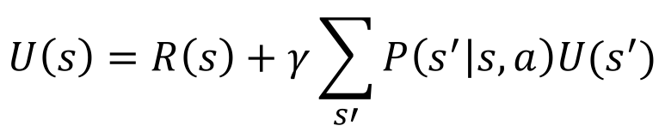
Last Time: Adaptive Dynamic Programming
Idea: what if we learn the transition model? Then perhaps we can take advantage of a Bellman-like calculation
$$U\left(s\right)=R\left(s\right)+γ\sum_{s′}{P\left(s^{′} | s,a\right)U(s^{′})}$$
(1,1)_{-0.04}, (1,2)_{-0.04}, (1,3)_{-0.04}, (1,2)_{-0.04}, (1,3)_{-0.04}, (2,3)_{-0.04}, (3,3)_{-0.04}, (4,3)₊₁
(1,1)_{-0.04}, (1,2)_{-0.04}, (1,3)_{-0.04}, (2,3)_{-0.04}, (3,3)_{-0.04}, (3,2)_{-0.04}, (3,3)_{-0.04}, (4,3)₊₁
(1,1)_{-0.04}, (2,1)_{-0.04}, (3,1)_{-0.04}, (3,2)_{-0.04}, (4,2)₋₁
(1,3)
(1,2)
(1,3)
(2,3)
P((2,3)|(1,3),Right)=2/3
(1,3)
(2,3)

Slide 5
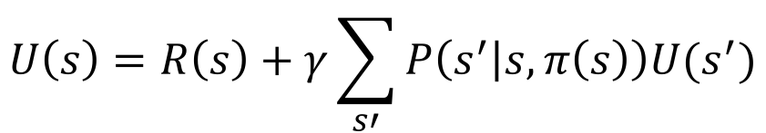
Active Reinforcement Learning
So if we learn the transition model using ADP, find an optimal policy based on this model, then are we done?
$$U\left(s\right)=R\left(s\right)+γ\sum_{s′}{P\left(s^{′} | s,π\left(s\right)\right)U(s^{′})}$$
What if we don’t spot this?
Russell and Norvig text ch 21

Slide 6
ADP Gone Wrong
Problem: agent does not fully explore the environment
Rusell and Norvig Figure 21.6

Slide 7
Exploration vs. Exploitation
Greedy agent (instantaneous rewards) very seldom converges to the optimal policy
Must tradeoff exploitation (to maximize reward) and exploration (to maximize learning the environment)
Common theme in learning problems

Slide 8
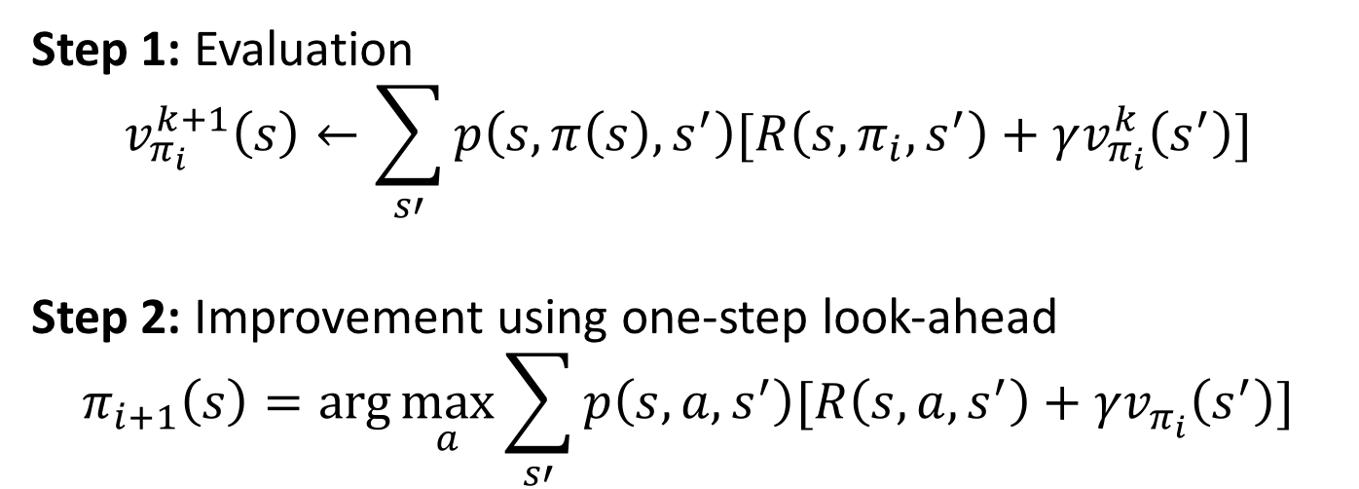
What About Learning a Policy?
How to learn about best action to take, not just the value of a particular state
Recall policy iteration:
Step 1: Evaluation
$$v_{π_{i}}^{k+1}\left(s\right)←\sum_{s′}{p\left(s,π\left(s\right),s^{′}\right)[R\left(s,π_{i},s^{′}\right)+γv_{π_{i}}^{k}\left(s^{′}\right)]}$$
Step 2: Improvement using one-step look-ahead
$$π_{i+1}\left(s\right)=\arg{\max_{a}{\sum_{s′}{p\left(s,a,s^{′}\right)[R\left(s,a,s^{′}\right)+γv_{π_{i}}\left(s^{′}\right)]}}}$$

Slide 9
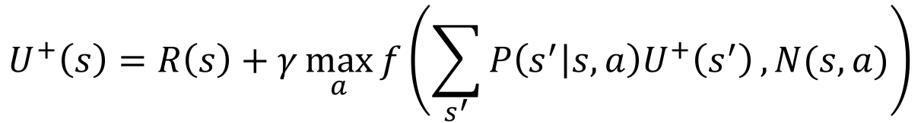
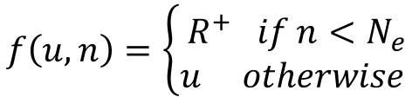
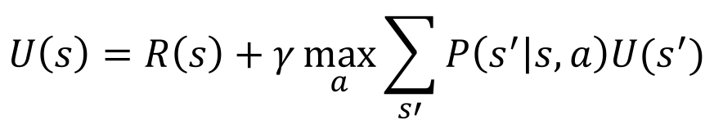
Active ADP
Let’s take a closer look at the utility of each state and see how we can make unexplored states have higher utility
An optimistic version would be
Example f
Notice that now we have a max over actions
Recall that ADP does not have the true transition probabilities
$$U\left(s\right)=R\left(s\right)+γ\max_{a}{\sum_{s′}{P\left(s^{′} | s,a\right)U(s^{′})}}$$
Let’s call this u
State-action pairs that have been less explored should look more valuable
$$U^{+}\left(s\right)=R\left(s\right)+γ\max_{a}{f\left(\sum_{s^{′}}{P\left(s^{′} | s,a\right)U^{+}\left(s^{′}\right)},N(s,a)\right)}$$
u
n
$$f\left(u,n\right)=\left\{\begin{aligned}R^{+} if n<N_{e} \\ u otherwise \end{aligned}\right.$$

Slide 10
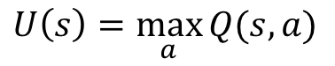
What About Model-Free Methods?
Recall the relationship between Q-values and utility values of a state s
$$U\left(s\right)=\max_{a}{Q(s,a)}$$
s
a
Choice of action
(agent)
stochasticity
s,a
Q-state
Stochastic state selection (environment)
s’

Slide 11
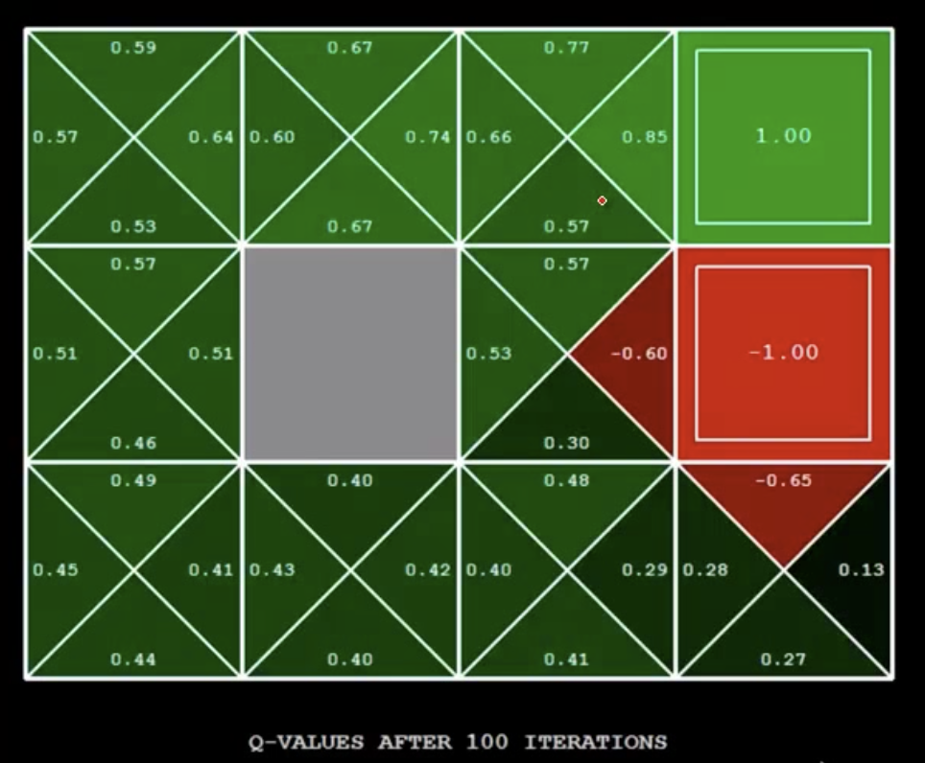
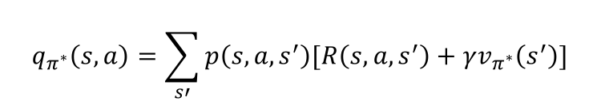
Simple Gridworld Q-values
$$q_{π^{∗}}\left(s,a\right)=\sum_{s′}{p\left(s,a,s^{′}\right)[R\left(s,a,s^{′}\right)+γv_{π^{∗}}\left(s^{′}\right)]}$$
Figure 17.1 in Russell and Norvig text
CS188 Spring 2014 Berkeley AI Lectures

Slide 12
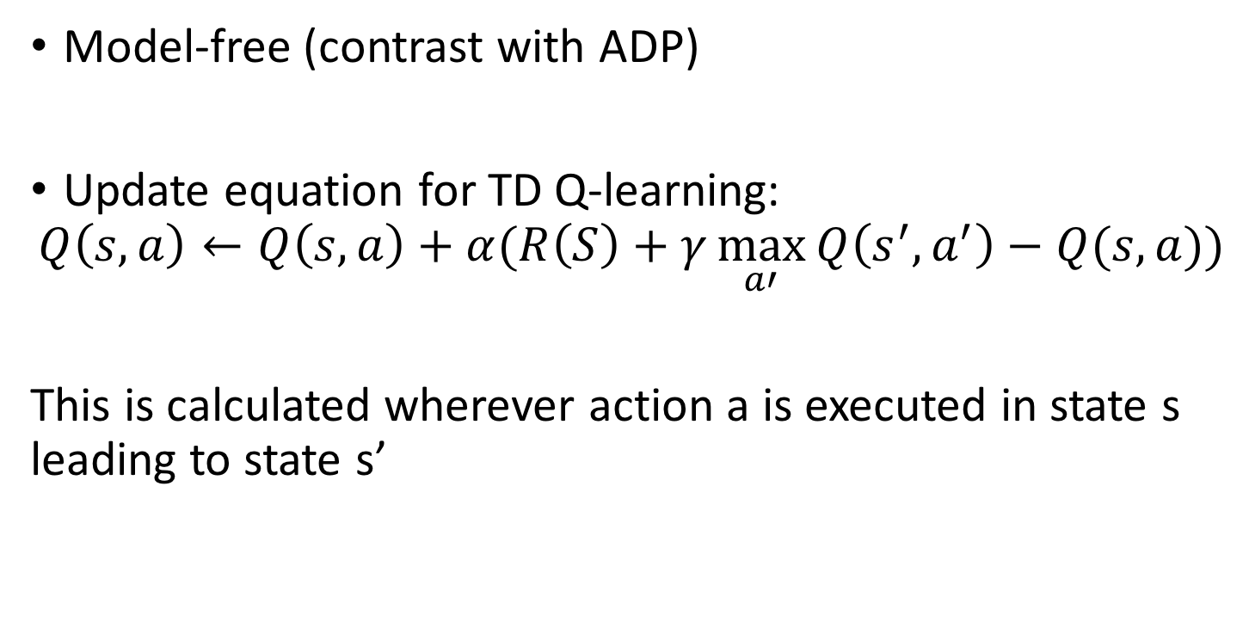
Q-Learning
Model-free (contrast with ADP)
Update equation for TD Q-learning:
$$Q\left(s,a\right)←Q\left(s,a\right)+α(R\left(S\right)+γ\max_{a′}{Q\left(s^{′},a^{′}\right)−Q(s,a))}$$
This is calculated wherever action a is executed in state s leading to state s’

Slide 13
Q-Learning
Off-policy learning (tries to estimate the optimal policy, independent of current policy)
$$Q\left(s,a\right)←Q\left(s,a\right)+α(R\left(s\right)+γ\max_{a}{Q\left(s^{′},a^{′}\right)−Q(s,a))}$$
Sutton and Barto text p107

Slide 14
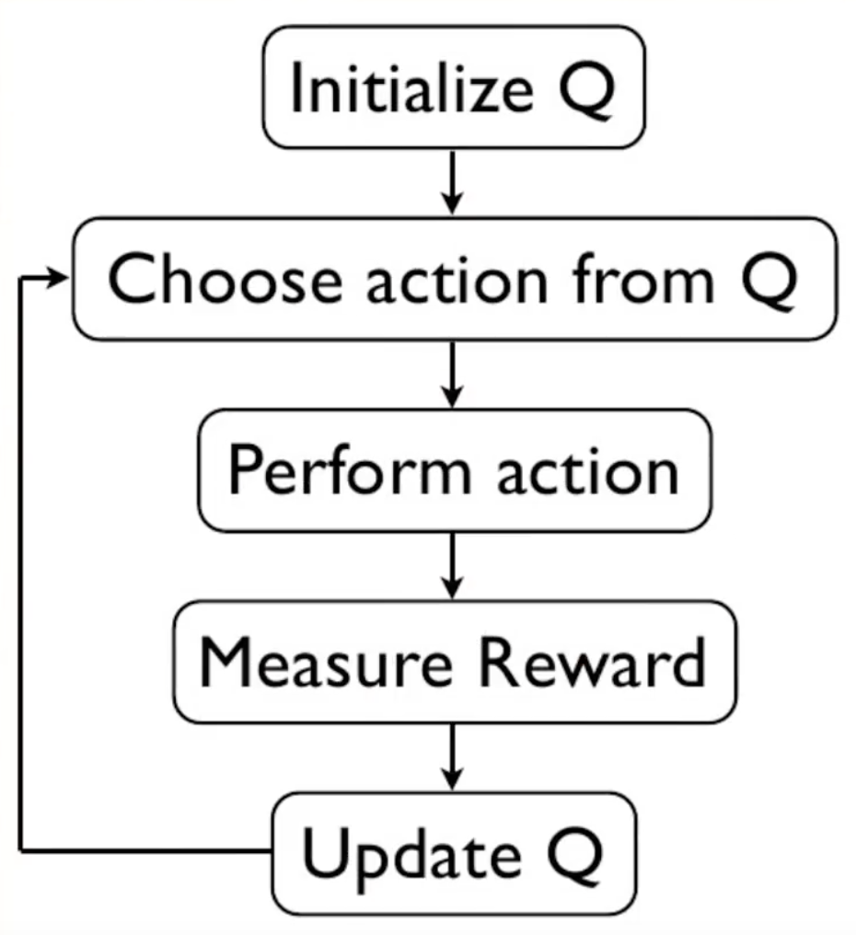
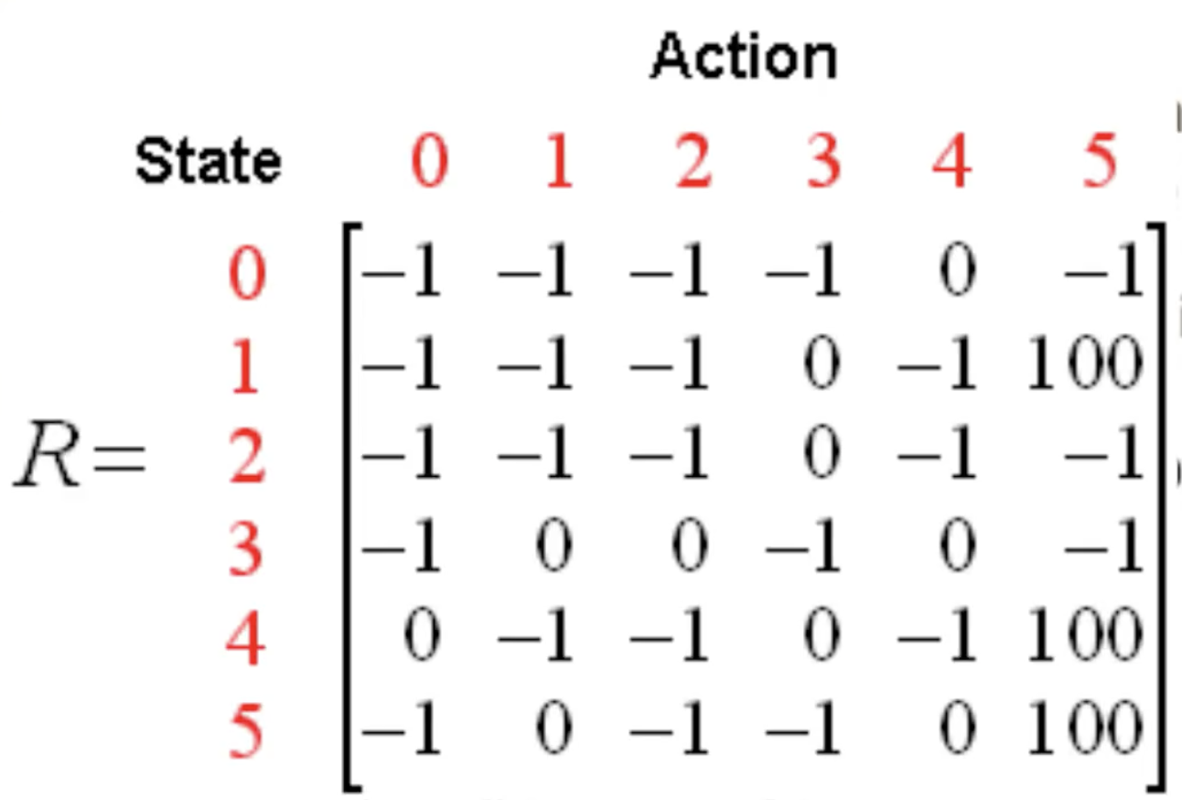
Q-learning Idea
0
0
0
0
0
0
0
0
0
0
0
0
0
0
0
0
0
0
0
0
0
0
0
0
0
0
0
0
0
0
0
0
0
0
0
0

Slide 15
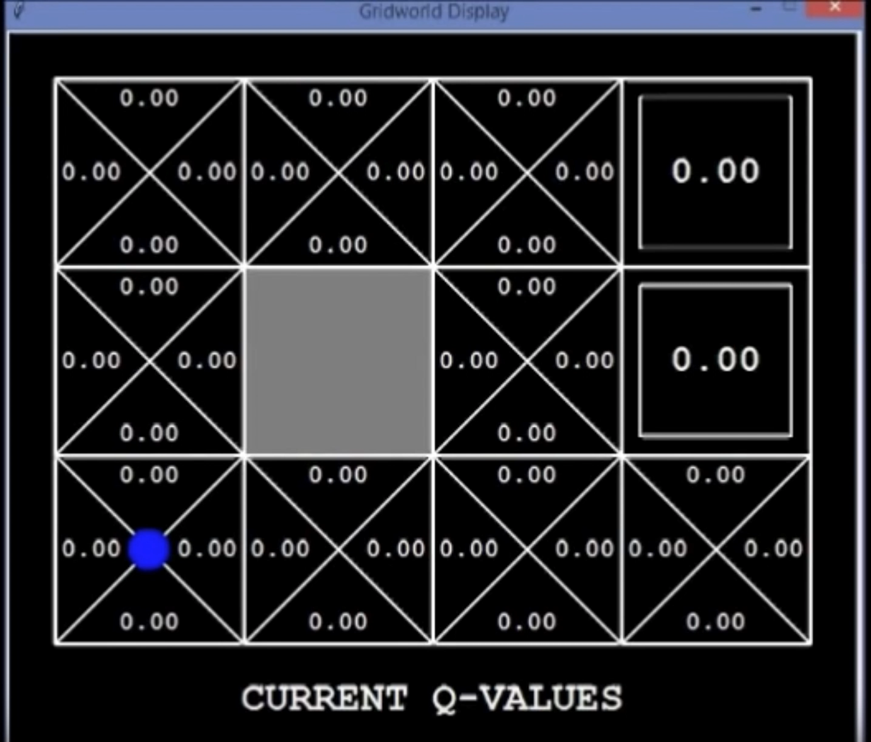
Q-Learning Implementation Example

Slide 16
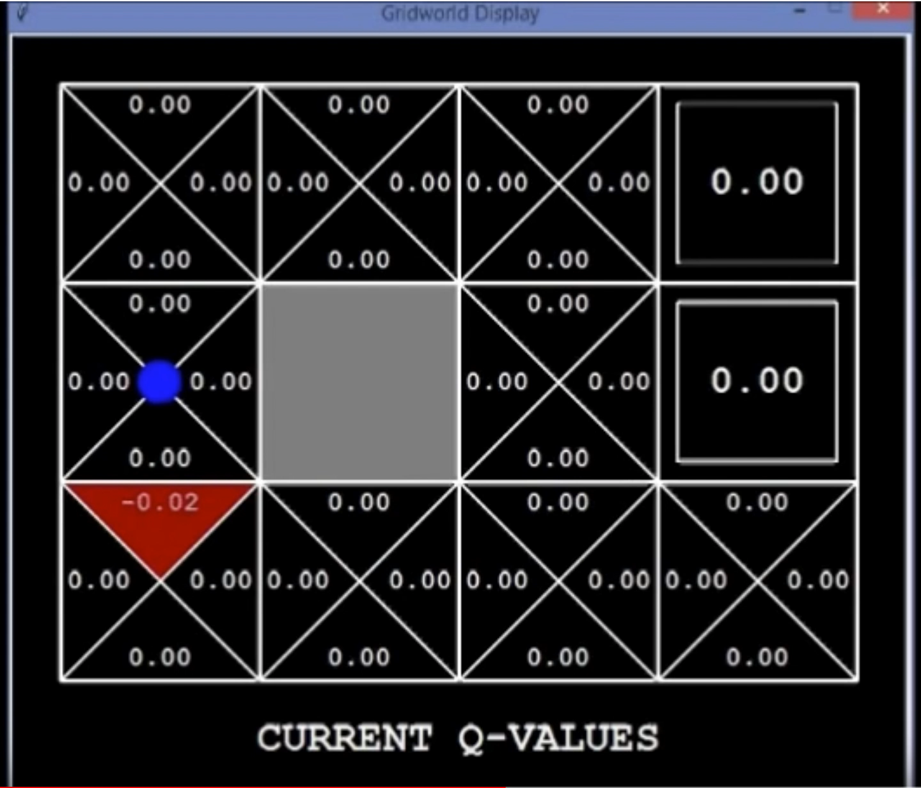
Q-Learning Implementation Example

Slide 17
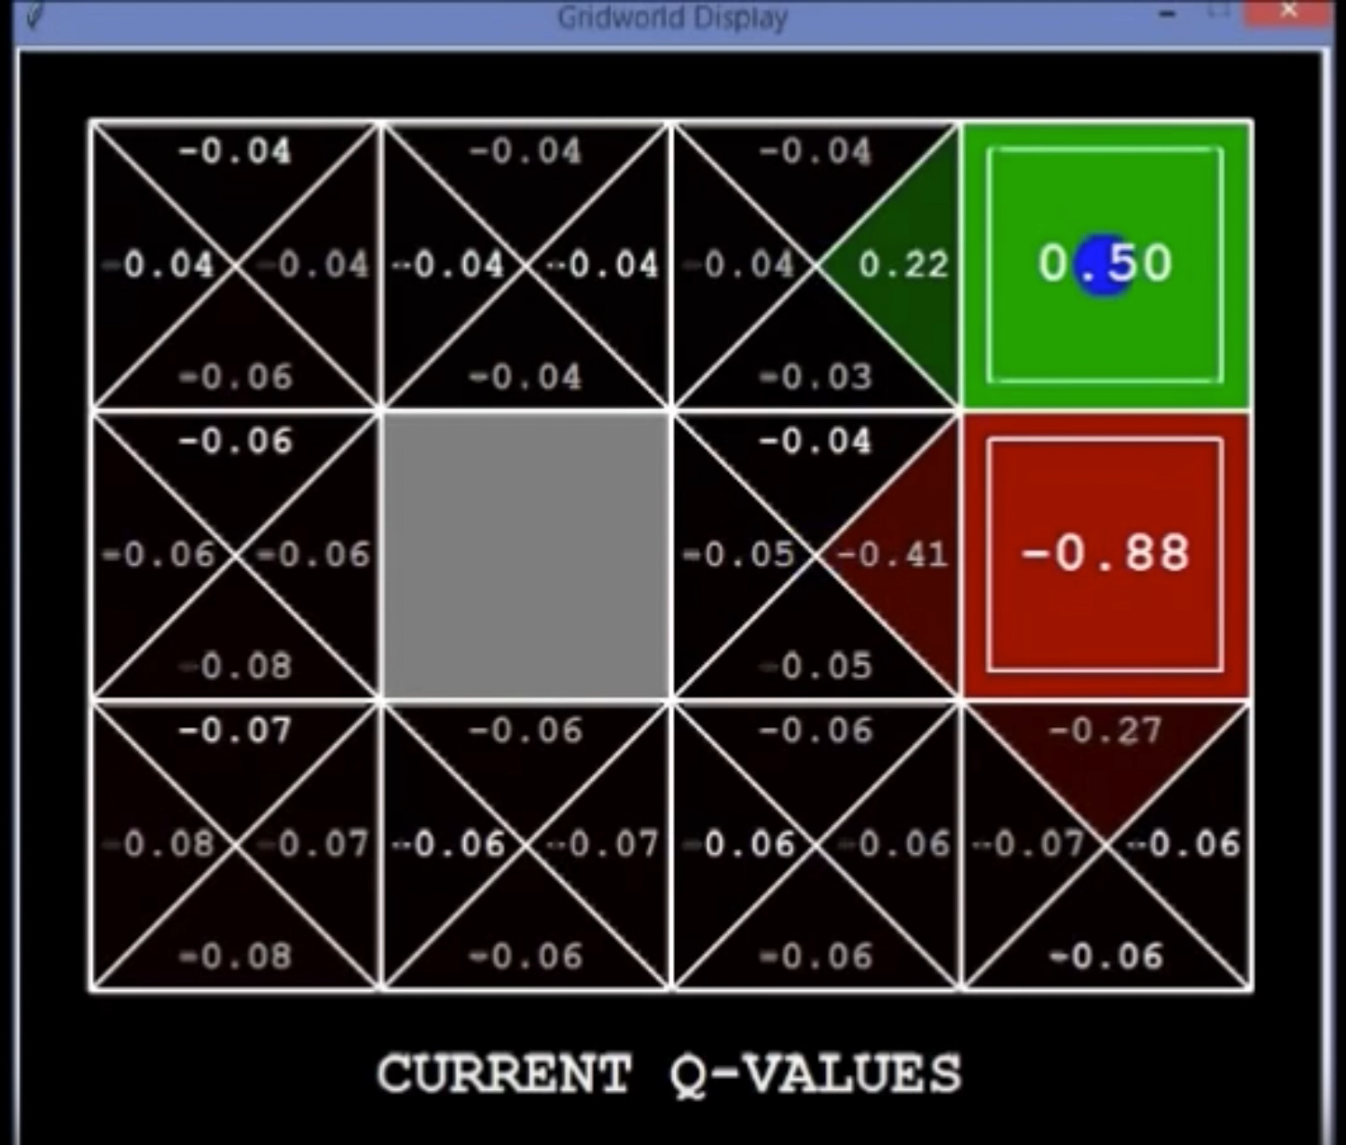
Q-Learning Implementation Example

Slide 18
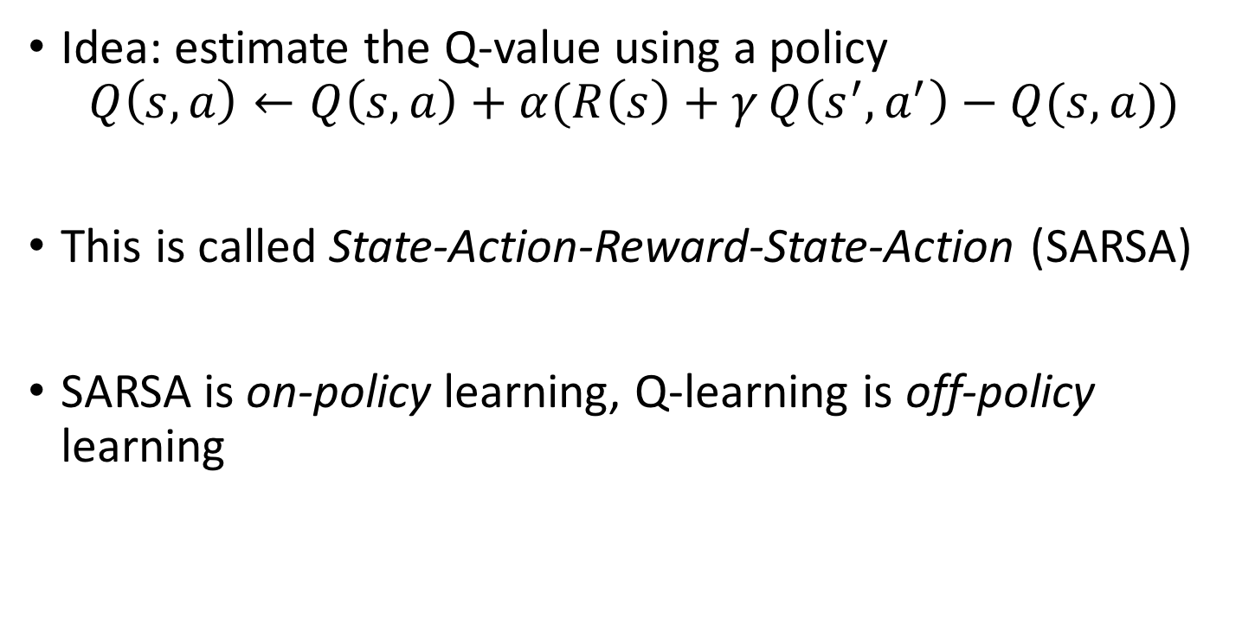
SARSA
Idea: estimate the Q-value using a policy
$$Q\left(s,a\right)←Q\left(s,a\right)+α(R\left(s\right)+γQ\left(s^{′},a^{′}\right)−Q(s,a){)}$$
This is called State-Action-Reward-State-Action (SARSA)
SARSA is on-policy learning, Q-learning is off-policy learning

Slide 19
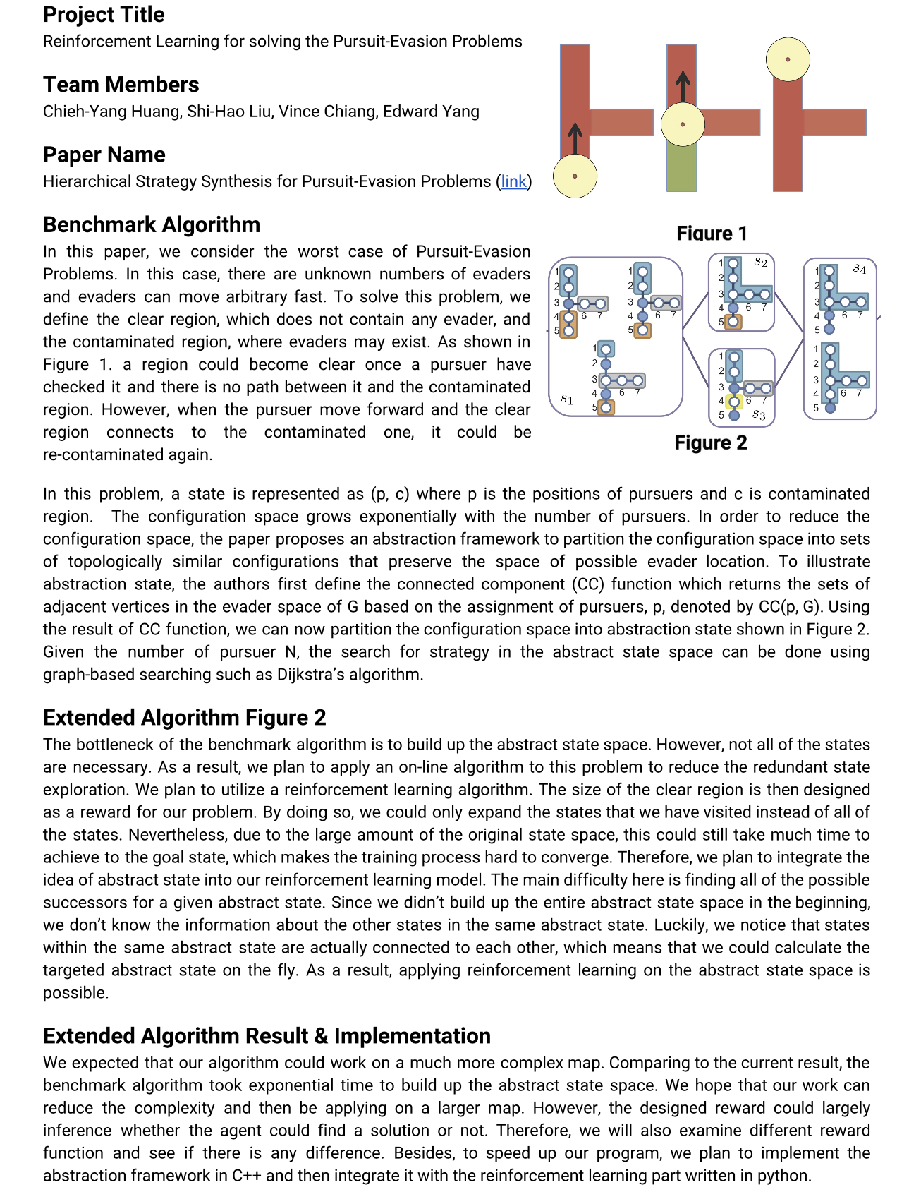
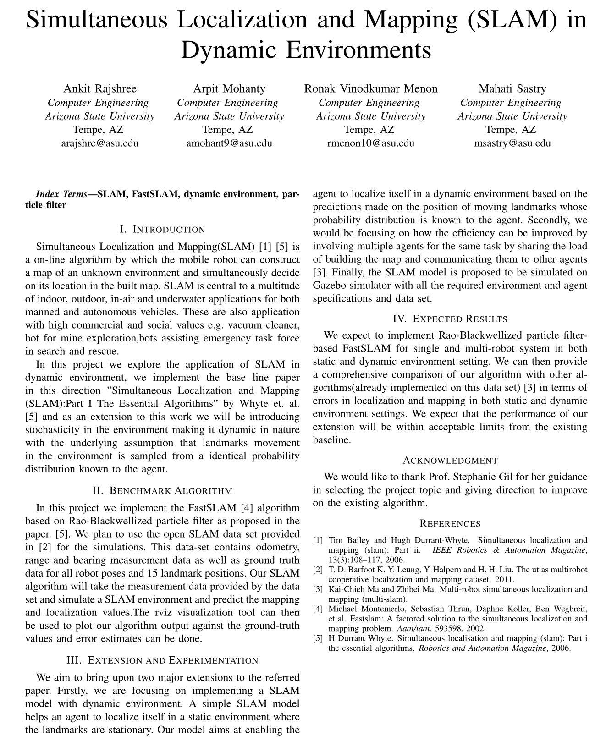
Some Notes about Final Project
Benchmark algorithm
Problem addressed
Extension to the benchmark
Expected result

Slide 20
Midterm Results
Average was 75.23
Standard deviation was 7.74
How to interpret your midterm result:
Average is about a B+
One standard deviation above the mean is roughly A-
One standard deviation below the mean is roughly B
Two standard deviations above is roughly A, three is roughly A+
Two standard deviations below is roughly B-, thee below is roughly C+

Slide 21
Next Time
Wrap up reinforcement learning
Partially observable states!
Hidden Markov Models

